Slide 1

“Uber Ride Demand Patterns in NYC”
The Hidden Impact of Urban Mobility
Mohit Patel
February, 2026
Data Analyst Portfolio Project
In a city where traffic never sleeps,
are we still in control of our rides
or are our rides controlling us?

Slide 2
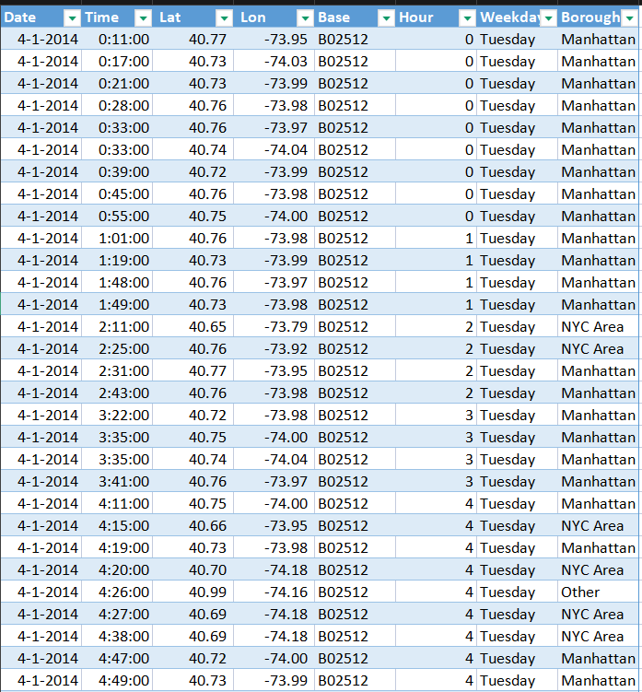
Behind the Wheel – Our Data Story
Source: Kaggle – Uber Pickups in New York City (FiveThirtyEight, 2014)
Purpose: Explore patterns in Uber ride demand to understand peak times, locations, and business opportunities.
April 2014: ~565,000 rides
Key Columns:
Date/Time (timestamp of pickup)
Lat, Lon (pickup location)
Base (Uber affiliate code)
Cleaning Steps:
Parsed timestamps
Added Hour, Day of Week, Approximate Borough
Removed invalid Lat/Lon (outliers)

Slide 3
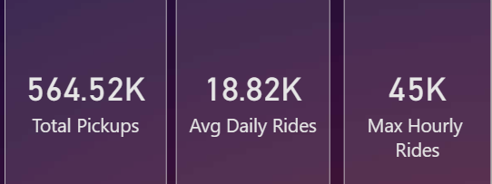
Key Metrics – April 2014
Total Pickups: 565K
Average Daily Rides: 18.82K
Max Hourly Rides: ~45K (across all days)
Insight: Half a million rides in just one month — huge scale!

Slide 4
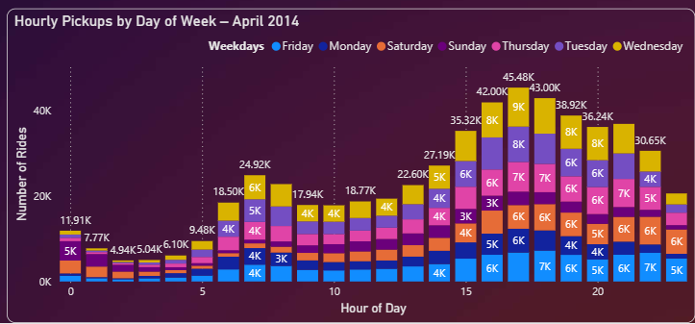
Are weekday evenings more intense?
Evening rush (5–8 PM) clearly dominates weekdays.
Wednesday shows the highest single-hour peak.
Weekends are quieter — different pattern.

Slide 5
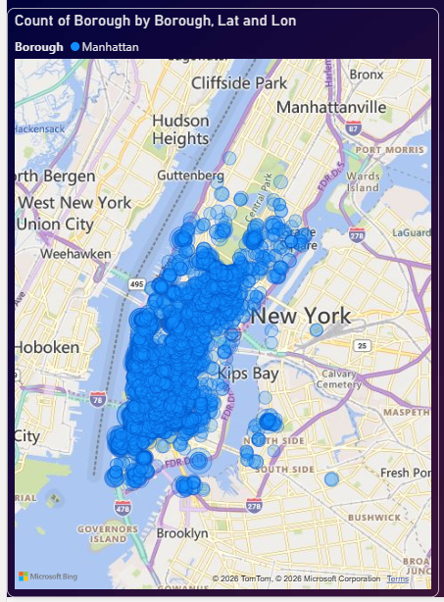
Does location play a hidden role?
86% of rides in Manhattan (486K out of 565K)
Central areas (Manhattan) drive almost all rush-hour spikes.
Outer boroughs have much lower volume.

Slide 6
From Awareness to Action – What We Learned
Our data journey isn’t about blame — it’s about balance.
Yes, weekday evenings show significantly higher demand (peaks at 5–8 PM).
Yes, Manhattan dominates (86% of rides).
But awareness is the first step toward better operations:
  More drivers during rush hours
  Targeted surge pricing
  Reduced wait times for riders

Slide 7
Thank You!
Questions?
Feel free to connect: Mohit Patel mohitpatel24266@gmail.com

